Slide 1
Capstone Project – Report
“The Battle of Neighbourhoods”
in Toronto

Slide 2
INTRODUCTION / BUSINESS PROBLEM:
The current study will try to provide an optimum location for opening a new business in Toronto city, based on:
A neighbourhood’s property, e.g. the second most common language spoken (after English) in the neighbourhood,
The number of competitors in the neighbourhood,
The population density in the neighbourhood.
The average income of the neighbourhood.

Slide 3
DATA DESCRIPTION:
The datasets that will be used are for retrieving information about city’s neighbourhoods and their characteristics are taken from Wikipedia website for the Toronto demographic information:
•https://en.wikipedia.org/wiki/Demographics_of_Toronto_neighbourhoods
The geographic coordinates of the neighbourhoods of Old Toronto are taken from:
• File 'oldToronto.csv' which the latitude and longitude per neighbourhood in Toronto area.

Slide 4
METHODOLOGY:
1. Data wrangling
For first step, the information in the Wikipedia link has to be
transformed in a suitable form that enables further dataframe
analysis.
2. Add coordinates to the demographic data
Add latitude and longitude data, by merging the demographic
dataframe and the neighborhoods.
The result is the following dataframe.
A map depicts the neighborhoods
As shown below:

Slide 5
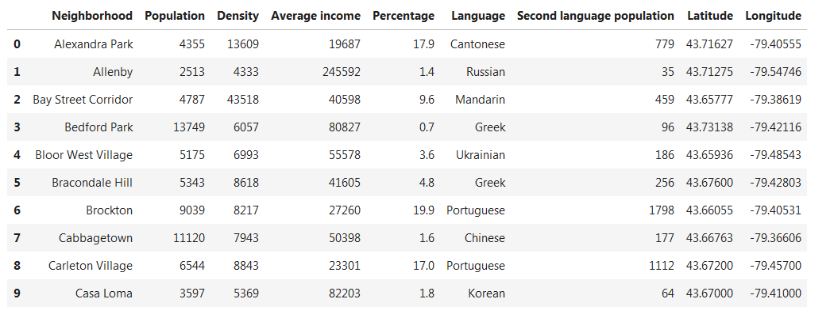
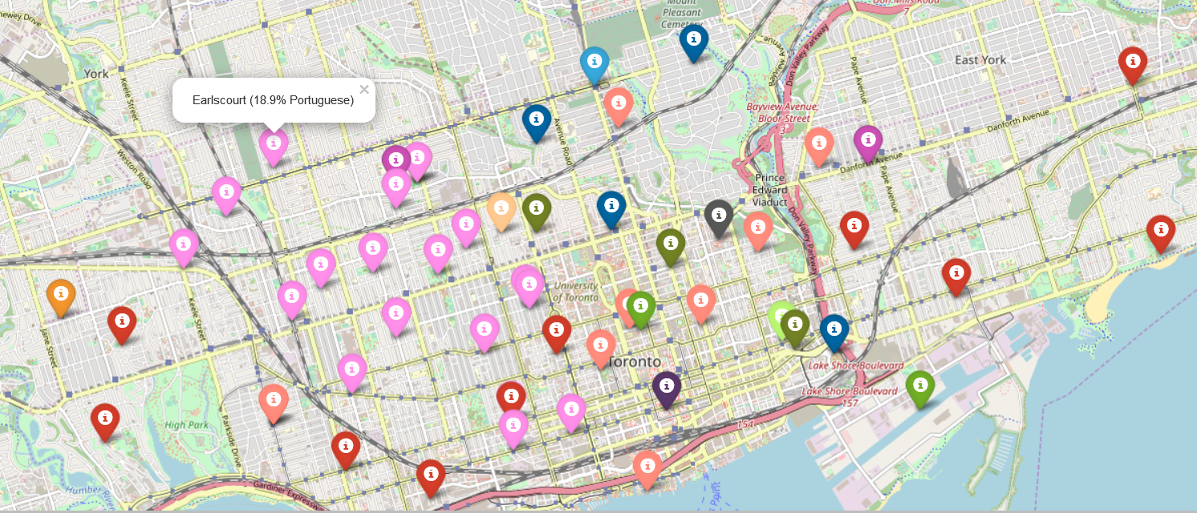

Slide 6
Foursquare API
Use the Foursquare API, to get the venues for each neighborhood.
Further filter for limiting to “Restaurants’ only.
Assume language groups:
For Portuguese assume common ethnic group for Brazilian and
Portuguese Restaurants.
For Japanese assume common ethnic group for Sushi and Japanese
Restaurants.
For Cantonese assumed common ethnic group for Thai, Taiwanese,
Vietnamese, Cantonese, Indonesian Restaurants.
For Mandarin as Chinese for Chinese Restaurant. )

Slide 7
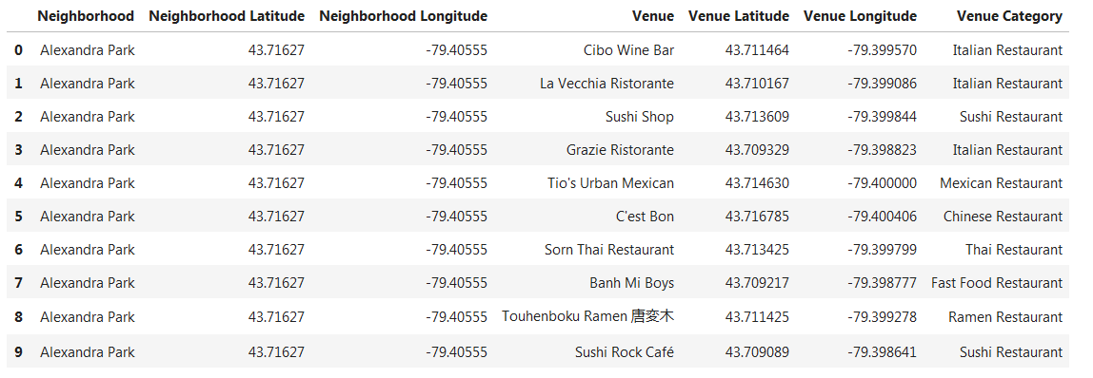
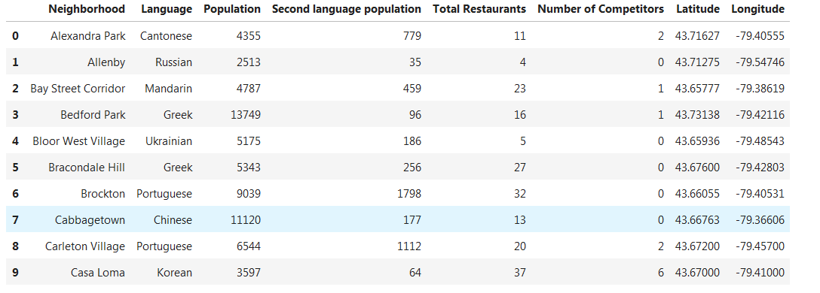
The competition per area:
The summary of total restaurants per area and competition:

Slide 8
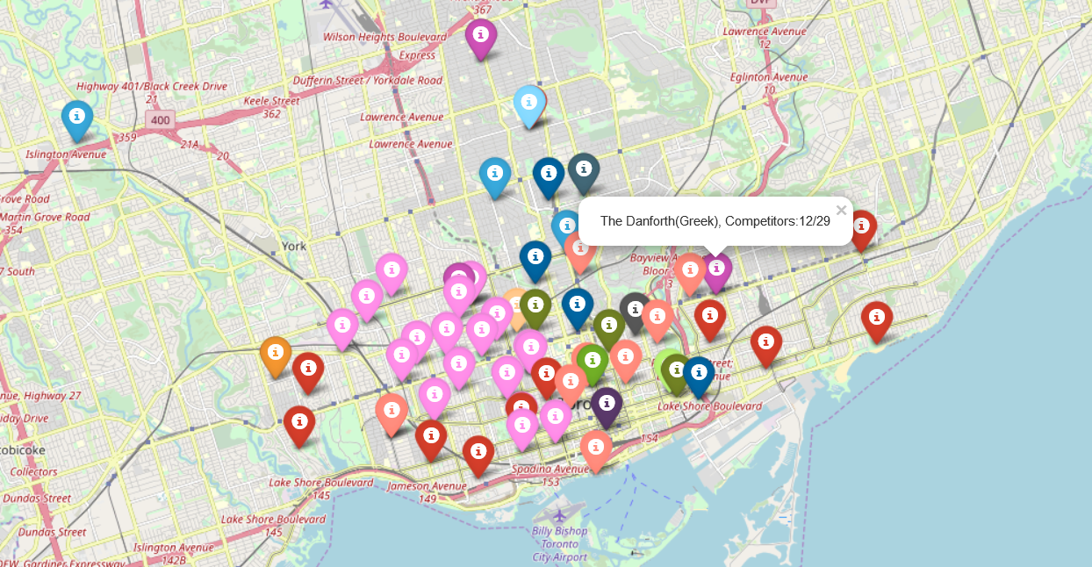
We can then visualize in a map the number of competitors for each neighborhood:

Slide 9
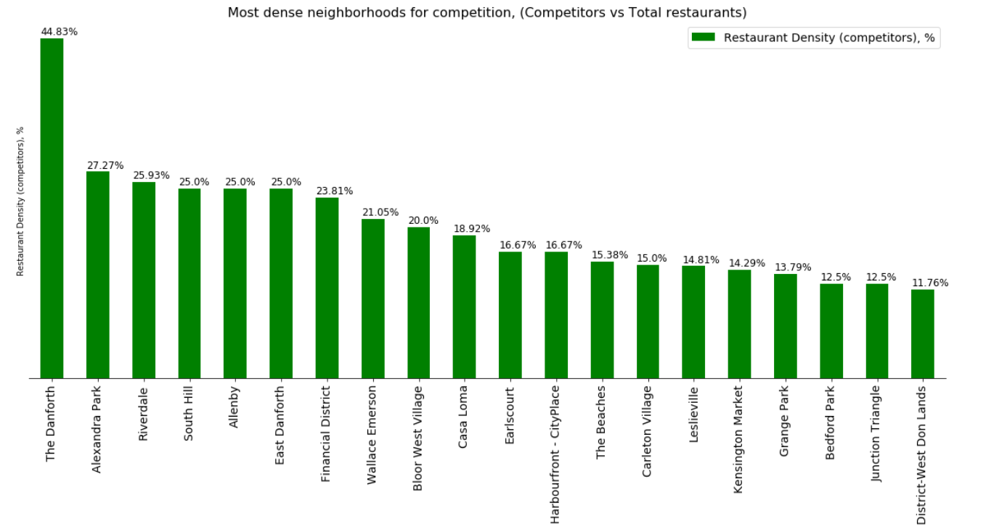
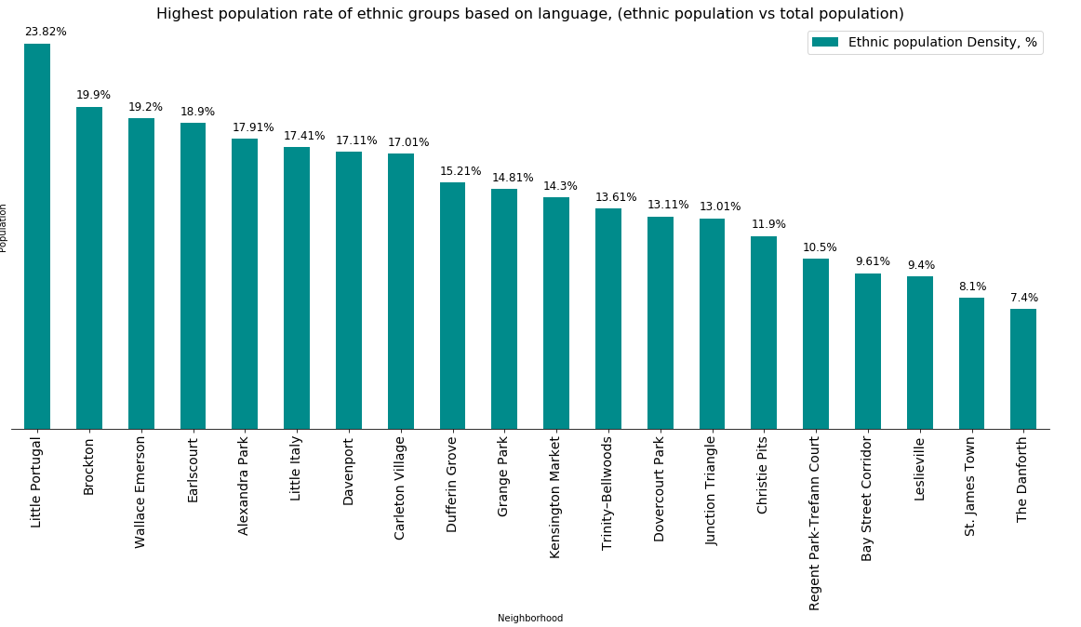
Introduce weight factors
Density of ethnic group restaurants
Density of ethnic population

Slide 10
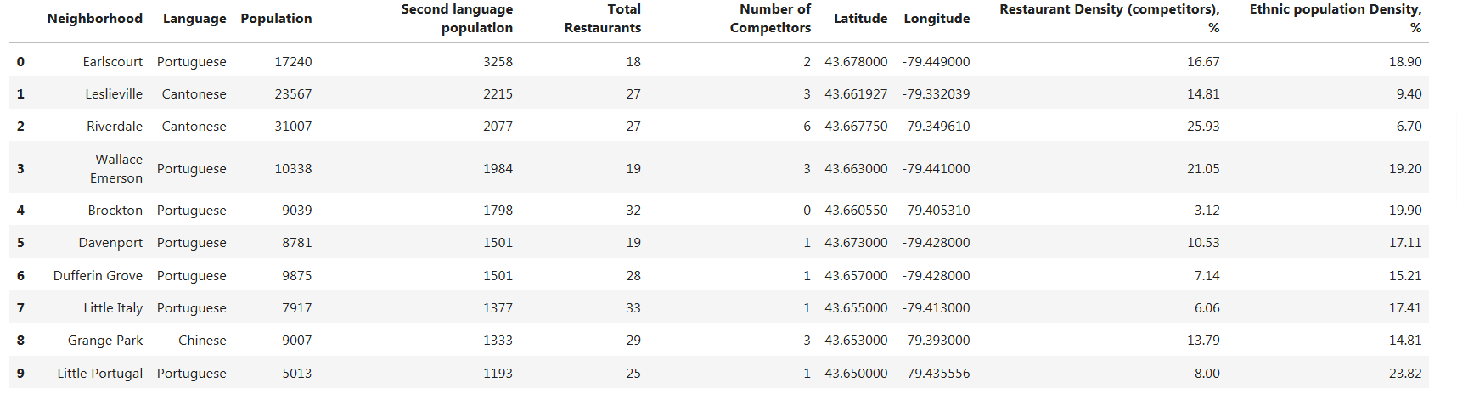

Slide 11
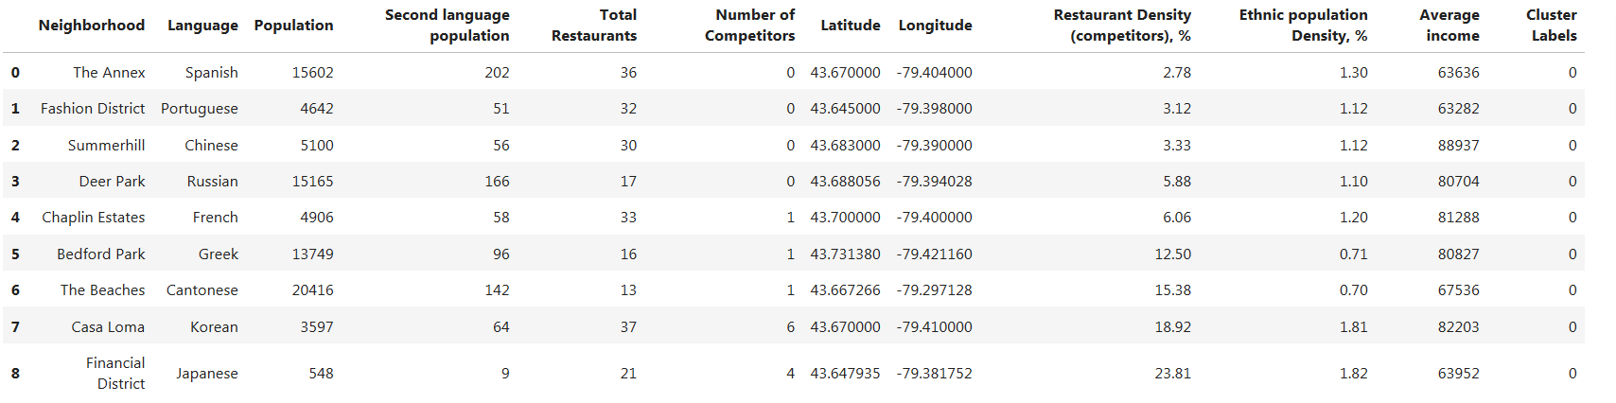

Results
Analysis of results by machine learning (k-means)
k = 5 clusters
Cluster0
Cluster1

Slide 12
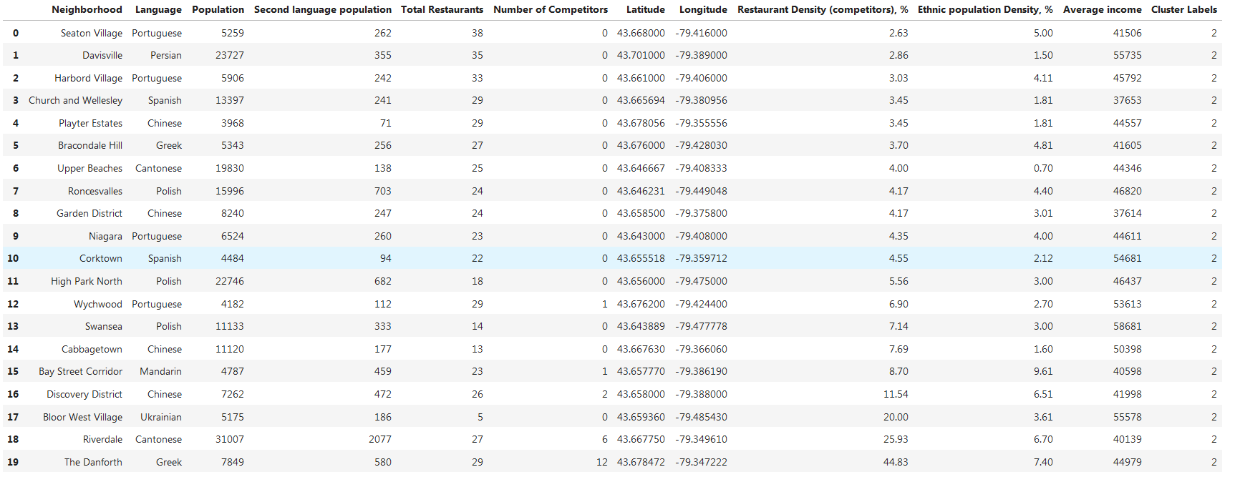
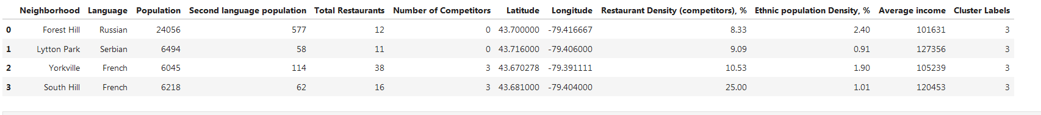
Cluster2
Cluster3

Slide 13
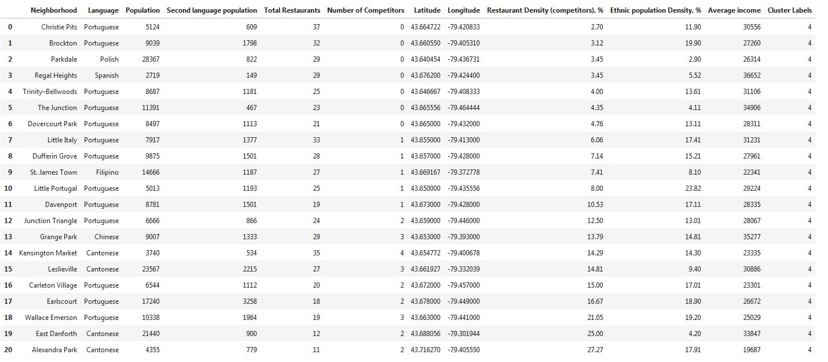
Cluster4

Slide 14

The best option to open an ethnic Persian restaurant
is “Davisville”. This area has less competition, and second
best population from other candidates. It is in area with average income, i.e. can attract better all classes equally, in contrast to “Forest Hill” which seems rather expensive.
The ‘Average income’ was the most distinctive property for the
neighborhoods, more important than other significant properties such as the population. Below the best candidates, based on “Average income”:
Discussion/Conclusion

Slide 15
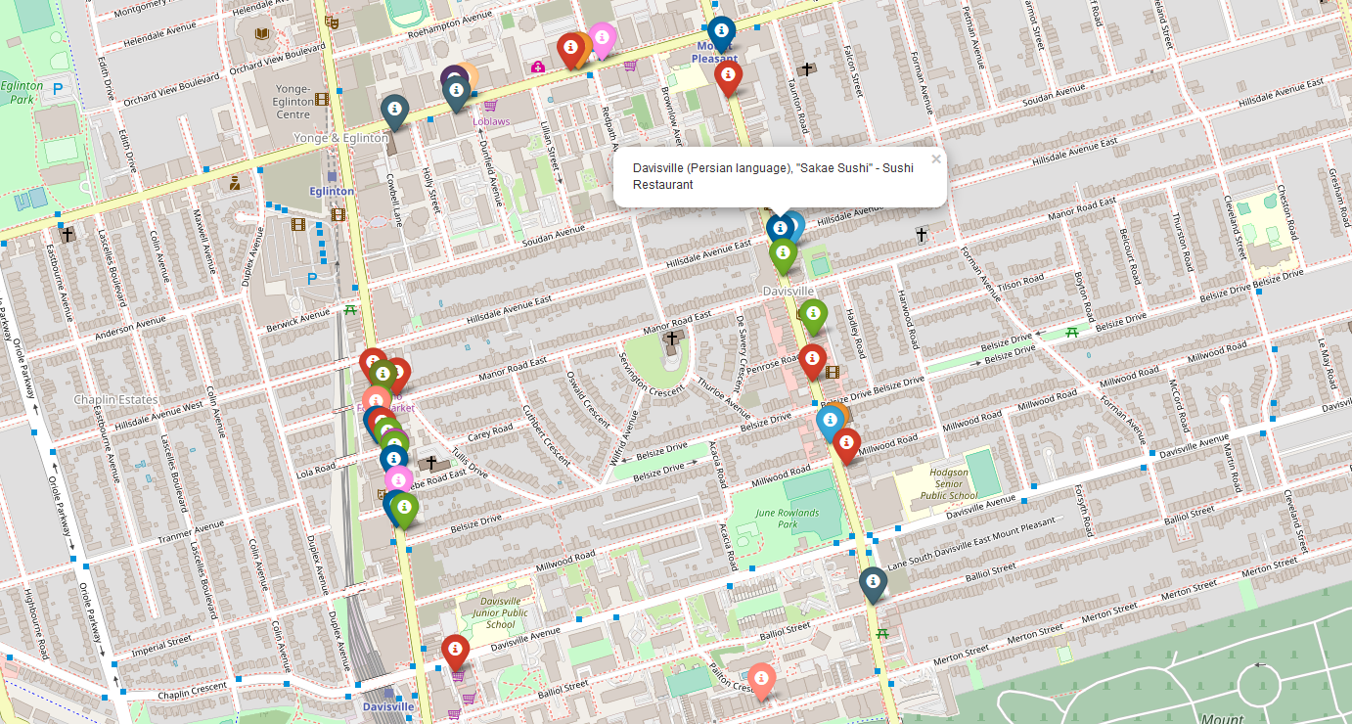
Below a map of competition in Davisville:
(restaurant types are represented via different colors):

